Slide 1

Implementing a Chatbot using the DeepPavlov Framework
Mohammed Yasser BENIGMIM
Supervisors : Raphaël TRONCY, Thomas SCHLEIDER, Thibault EHRHART
Data Science Department- EURECOM

Slide 2



“ Create a chatbot on tourism using DeepPavlov framework ”
Duration of the Project : 8th March 12th June (~3 months)
Weekly meetings
Feedbacks and Improvement Tracks

Slide 3
Summary :
State of the Art : NLP, chatbots
DeepPavlov : Named Entity Recognition, Goal oriented bot
Tourism chatbot
Future Work : RoadMap
Conclusion

Slide 4
State of the Art

Slide 5

Natural Language Processing
NLP is a subfield of Artificial Intelligence.
NLP describes the ability of a machine to understand the meaning of a sentence and finally determine the appropriate action.
NLP can be divided into two parts :
Natural Language Understanding (NLU) : understands the intent and the parameters of the sentence.
Natural Language Generation (NLG) : generate the according answer to the sentence.

Slide 6


85%
The percentage of customer interactions that will be handled with a chatbot in 2020.
- Gartner Report

Slide 7

Chatbots
A chatbot is considered as : “ A computer program designed to simulate conversation with human users, especially over the Internet ”.
Artificial intelligence made it possible for chatbots to “learn”.
“Intelligence” to perform tasks, solve problems without human intervention.

Slide 8
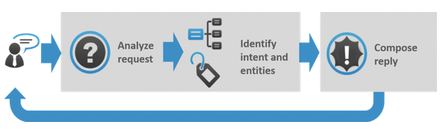
How it works
General mechanism :

Slide 9
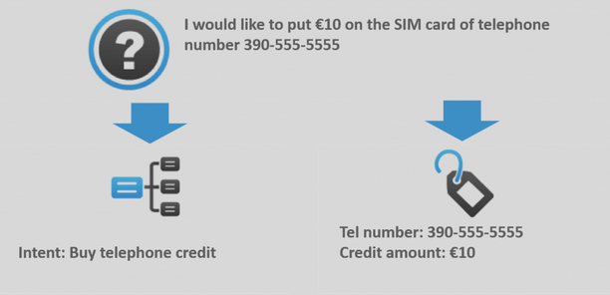
How it works
Functioning of the NLU :

Slide 10
DeepPavlov

Slide 11

Presentation of DeepPavlov
Deep learning-based library for creating chatbots
Created in June in 2018 by Neural Network and Deep Learning Lab of the Moscow Institute of Physics and Technology (MIPT) in a project called iPavlov
DeepPavlov contains lot of components : Named Entity Recognition, Intent classifier, etc…
Different kind of bots : Goal-oriented bots, chit-chat models, etc ...
One of the 10 teams selected for the Alexa Prize Socialbot Grand Challenge 3 !

Slide 12
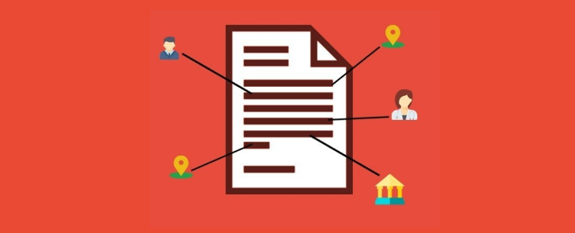
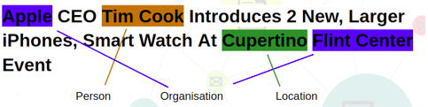
Named Entity Recognition
Subtask in the NLU, classifies named entities present in a text in to pre-defined categories like “individuals”, “companies”, “cities”, “dates” etc ...
We should not confuse between the intent and the entities !

Slide 13
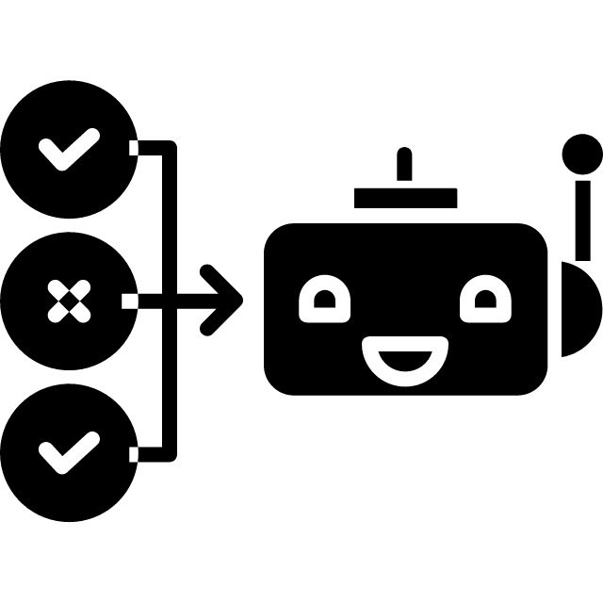
Goal oriented bot
A goal-oriented (GO) chatbot attempts to solve a specific problem for a user, it can help people book a ticket, find a reservation, etc …
2.5 Bn hours saved for businesses and consumers combined in 2023 ! - Juniper Research
Also called “virtual assistant”

Slide 14
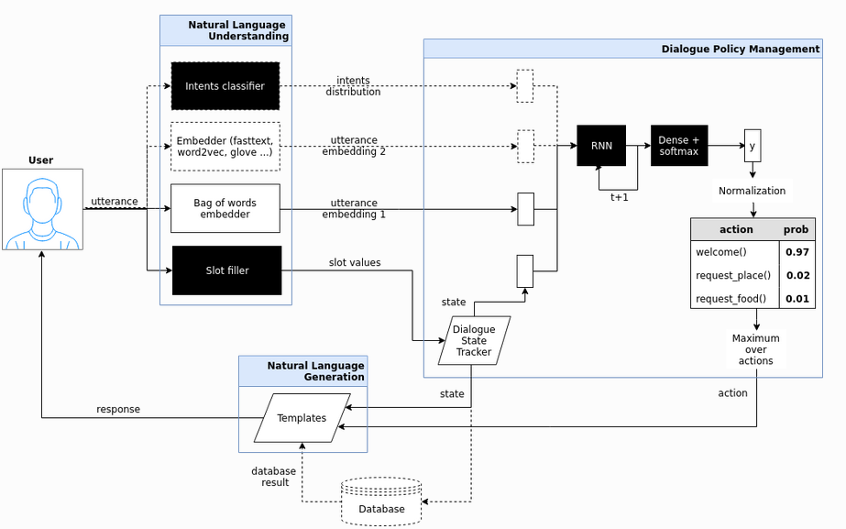
Goal oriented bot

Slide 15
Personal work

Slide 16



Tourism chatbot
Objective : “ Use the goal oriented bot provided by DeepPavlov to train it on a our personal dataset about tourism ”
Study the dataset accepted by the go_bot
Modify our personal dataset
Integrate it to the go_bot and interact with it

Slide 17


Study the dataset : DSTC 2
Dialogue State Tracking Challenge 2 : dataset about restaurant reservation
train/val/test file
SQLite Database
Template file

Slide 18
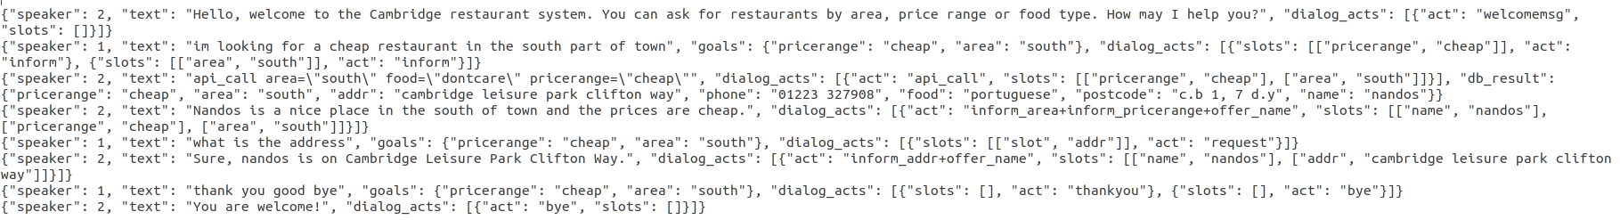
train/val/test file
Train the chatbot to recognize the restaurants and respond accordingly
training file : 967 dialogs
test file : 576 dialogs
validation file : 575 dialogs

Slide 19
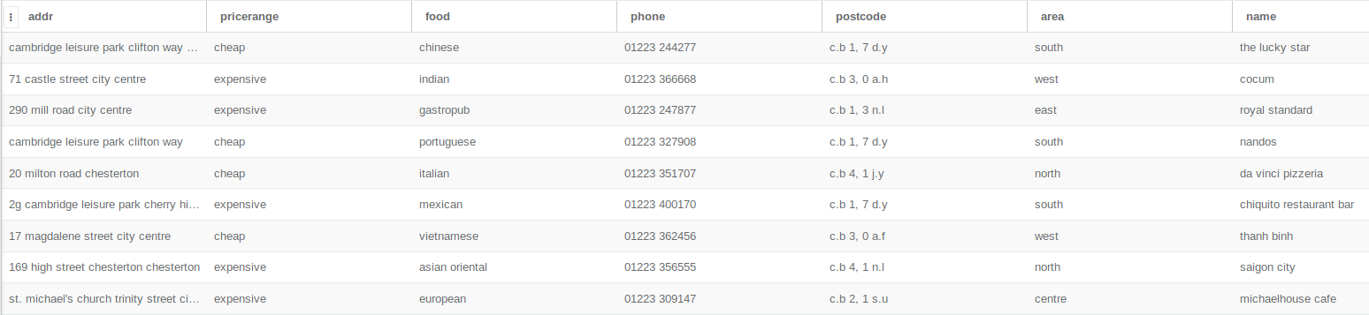
SQLite Database
Contains all the restaurants mentioned in the files with their attributes
101 different restaurants

Slide 20
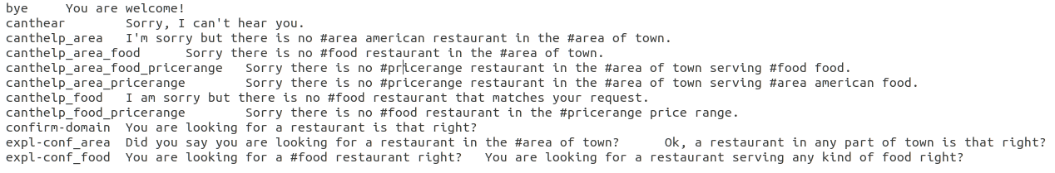
Template file :
provide a mapping from actions to text templates

Slide 21
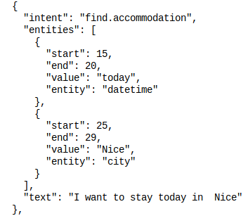
Modify our own dataset : RASA dataset
the concept of dialogue is not present
not suitable for our case

Slide 22
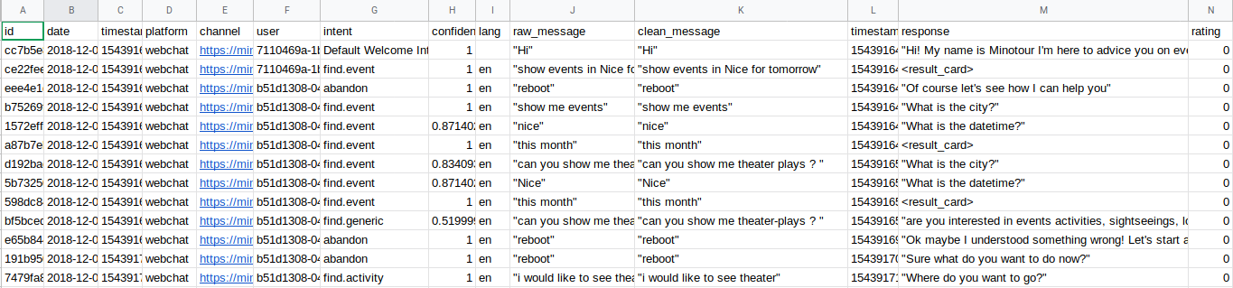
Minotour Chat logs
the key concept of dialogue is present

Slide 23

Comparison of the two datasets
Personal data :
DSTC 2 :

Slide 24
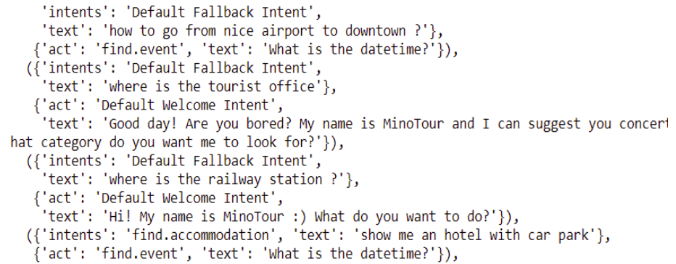
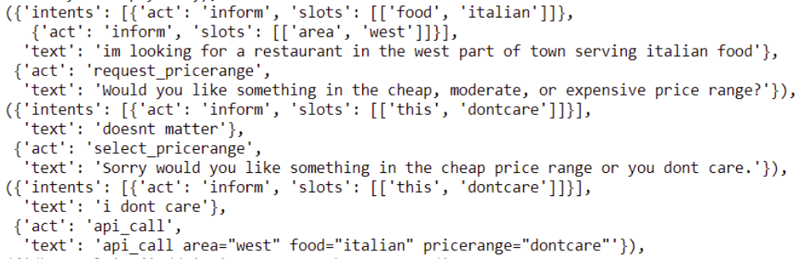
The output of the Dataset Readers
TOURISMReader :
not suitable for our case
DSTC2Reader :

Slide 25
Integrate new data in DeepPavlov
Integrate new data to the goal oriented bot of DeepPavlov
The dataset needs to have the exact form of the DSTC 2 dataset
it’s highly recommended to have a dataset about restaurant reservations

Slide 26

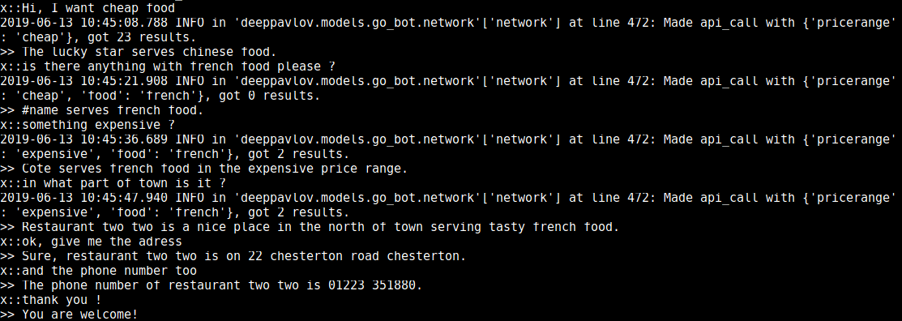
Interaction with the go_bot
After moving from Windows to Linux, we managed to interact with the go_bot :

Slide 27
Interaction with the go_bot
We tried to interact with the go_bot with new added data
Add the new restaurant in the SQLite database (previously seen food origin)

Slide 28
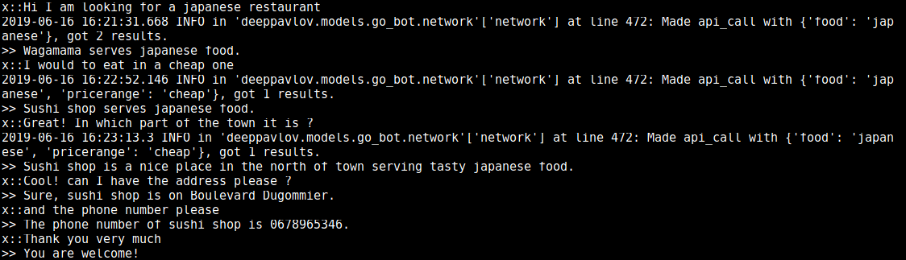
Interaction with the go_bot

Slide 29
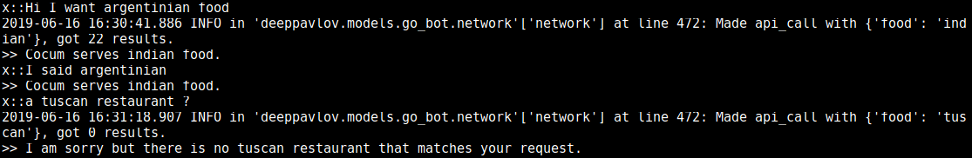
Interaction with the go_bot
Add the new restaurant in the SQLite database with new food origin (argentinian) that didn’t exist before in the DSTC2 dataset and the SQLite database
The Tuscan restaurant didn’t exist in the SQLite database, but was mentioned in the DSTC2 dataset !

Slide 30
Interaction with the go_bot
After adding a dialogue about the argentinian restaurant in the DSTC 2 dataset, we had some technical errors :
In the beginning we thought it’s about the length of the training set, so we deleted one random dialogue, but it was not the case :
The problem is purely technical, can be solved !

Slide 31
Demonstration

Slide 32
Future Work : RoadMap

Slide 33

Road Map :
Previously cited food origin
Add the restaurant in the SQLite database
Interact with the go_bot
Add new restaurant
Succesful interaction
new food origin
Add a dialogue about it in the DSTC2 dataset
Modify some python files

Slide 34
Conclusion :
Interesting
Challenging
Inspiring

Slide 35
Thank you !

Slide 36
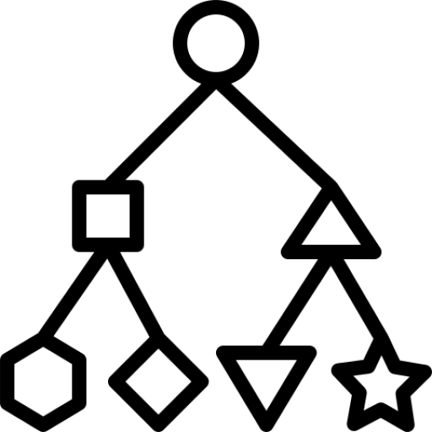
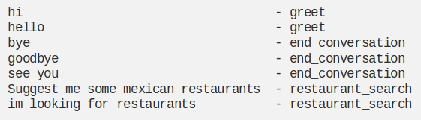
Intent classification
The core idea is to train the NLU of the chatbot to recognize the intent of each sentence.

Slide 37
Intent classification : SNIPS dataset
Aims to train a chatbot for intent classification.
Contains 15 000 rows (all different).
text | intent
Can you add a track to my Spain Top 50 playlist | AddToPlaylist
what is the weather forecast for Maryland | GetWeather
Give the Hollow Man three out of 6 stars | RateBook
Contains 7 differents intents : “SearchCreativeWork”, “GetWeather”, “BookRestaurant”, “PlayMusic”, “AddToPlaylist”, “RateBook”, “SearchScreeningEvent”

Slide 38
Intent classification : Work with new data
Minotour chat logs :
After modifying the dataset : 4159 rows ! (15 000 rows in the SNIPS dataset)

Slide 39
Intent classification : Results
Chat logs without any modification (4159 lines)
Chat logs without duplicates (1900 lines)
Chat logs without duplicates + 25% of SNIPS (5650 lines)
SNIPS dataset (15 000 lines)
56%
58%
82%
98%
size of data
variety of data
size of data

